Slide 1
Improving Natural Language Inference Using External Knowledge in the Science Questions Domain
Xiaoyan Wang
University of Illinois at Urbana-Champaign
Pavan Kapanipathi*, Ryan Musa, Mo Yu, Kartik Talamadupula, Ibrahim Abdelaziz, Maria Chang, Achille Fokoue, Bassem Makni, Nicholas Mattei, Michael Witbrock
IBM Research AI

Slide 2
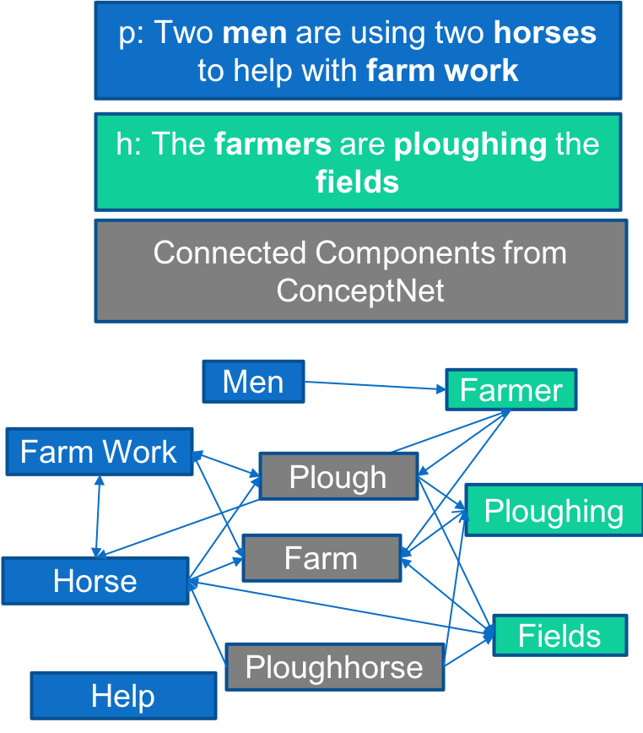
One Slide Summary
Natural Language Inference (Textual Entailment) is a fundamental problem for Natural Language Understanding
External knowledge can enhance the understanding of text and in turn improve NLI models. However, existing techniques lack the ability to harness external knowledge (from KGs)
Contributions
Framework that enables the use of external knowledge with text based systems for NLI
Our approach utilizes ConceptNet (external knowledge) and improves the performance of text based models on the Scitail dataset (Science domain entailment dataset)

Slide 3
Natural Language Inference
Natural language inference (NLI) is the problem of determining whether a natural language hypothesis h can reasonably be inferred from a natural language premise p. [MacCartney2009]
Example
p: Two men are using two horses to help with farm work.
h: The farmers are ploughing the fields
Central to Natural Language Understanding (NLU)
Semantic search
Question Answering
Summarization
Recent popularity due to creation of large scale crowd sourced datasets (Stanford)
SNLI
~ 570k sentence pairs
90.1%
MultiNLI (supports multiple genre)
~ 433K sentence pairs
~83%
Notes:
Define NLI
Give an example
Mention its applications

Slide 4
Natural Language Inference using External Knowledge
Motivation
Example
p: Two farmers are using two horses to help with farm work.
h: The men are ploughing the fields
Important to understand the the relationship between terms that can be fetched using external knowledge
Farmers and men
Farmers, farm work and ploughing
Working and ploughing corn
Lack of exploitation of existing knowledge sources
Goal
Analyzing the impact of relevant external knowledge for textual entailment
DBpedia, ConceptNet, WordNet
Develop hybrid models that can exploit information both from text and external knowledge

Slide 5
External Knowledge
Enhance text using concepts from External Knowledge
ConceptNet
Men
Farmer
p: Two men are using two horses to help with farm work
Plough
Ploughing
h: The farmers are ploughing the fields
Farm Work
Farm
Connected Components from ConceptNet
Fields
Horse
Ploughhorse
Help

Slide 6
Approach Overview
Classifier
Text Based Entailment Models
Encodes premise text and hypothesis text
Attention mechanisms
Classification
Graph Generator
Maps text to concepts in external knowledge
Generates graph based on the mapped concepts
Graph Based Entailment Model
Embeds the premise and hypothesis graph
Uses attention mechanism and classifies
Classifier
Feed forward
Input: Concatenation of final hidden layers of text and graph entailment model
Joint training
Text Based Entailment Models
Graph Based Models
Graph Generator
Premise
Hypothesis

Slide 7
Textual Based Entailment Models
Exploring existing approaches for our text based entailment models
Existing approaches for Text Based Entailment Models
DecompAttn
DeIsTe [Yin2018]
Match-LSTM [Wang2016]
Model | Accuracy
DecompAttn | 72.3
DeIsTe | 82.1
Match-LSTM | 84.1
CAFE | 83.3

Slide 8
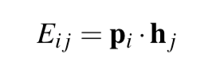
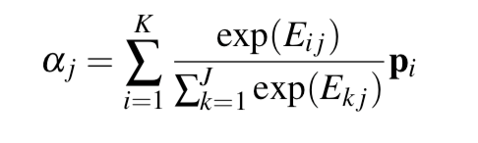
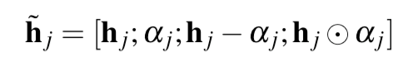
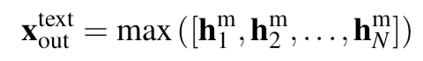
Text Based Entailment Models
Match LSTM
match-LSTM is used diverse NLU tasks including question answering
match-LSTM performed significantly better than the baselines
Detail of match-LSTM Model
Context Encoding
BiLSTMs on premise word vectors and hypothesis word vectors
Word by Word Attention
Matcher
Pooling

Slide 9
Graph Generator
p: Two men are using two horses to help with farm work
h: The farmers are ploughing the fields
Mapping from text to concepts in KB
Farmers → conceptnet.io/en/farmers
Ploughing → conceptnet.io/en/ploughing
Graph construction for premise and hypothesis
Concepts
Edges between mentioned concepts
PREMISE GRAPH
HYPOTHESIS GRAPH
Men
Farmers
Ploughing
Farm Work
Fields
Horse
Help

Slide 10
Graph Generator
p: Two men are using two horses to help with farm work
h: The farmers are ploughing the fields
Mapping from text to concepts in KB
Farmers → conceptnet.io/c/en/farmers
Ploughing → conceptnet.io/c/en/ploughing
Graph construction for premise and hypothesis
Concepts
One Hop
All concepts one hop from the mentioned concepts
Connected Components from ConceptNet
PREMISE GRAPH
Men
Farmers
Plough
Ploughing
Farm Work
Farm
Fields
Horse
Soccer
Horse Riding
HYPOTHESIS GRAPH
Help
Body Heat

Slide 11
Graph Generator
p: Two men are using two horses to help with farm work
h: The farmers are ploughing the fields
Mapping from text to concepts in KB
Farmers → conceptnet.io/en/farmers
Ploughing → conceptnet.io/en/ploughing
Graph construction for premise and hypothesis
Concepts
One Hop
Two Hop
Concepts included that connect concepts mentioned in premise for premise graph
Connected Components from ConceptNet
PREMISE GRAPH
Men
Farmers
Plough
Ploughing
Farm Work
Farm
Fields
Horse
HYPOTHESIS GRAPH
Help

Slide 12
Graph Based Entailment Model
Graph based entailment model
Given premise graph and hypothesis graph from the Graph generator, outputs a class
Pretrained concept embeddings based on existing knowledge graph embeddings
KG Embeddings: ComplEx, TransH, etc
KG: ConceptNet, Dbpedia, Wordnet
Models
MatchLSTM – For concepts only – sequenced based on length and text sequence
GconAttn

Slide 13
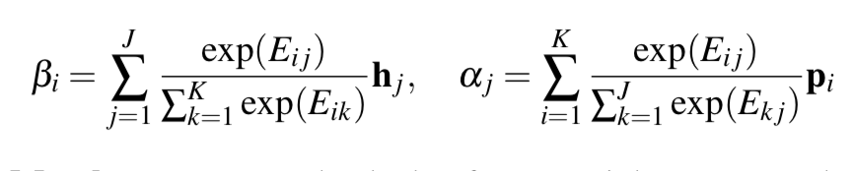
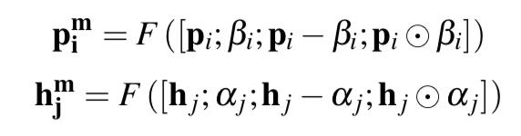
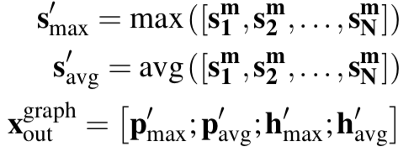
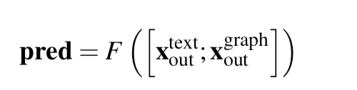
Graph Based Entailment Model – GconAttn Model
Details of Graph Based Entailment Model
Input is the concept embeddings trained using the corresponding KG
Attention Layer
Matcher
Pooling
Merging Text and Graph Based entailment model

Slide 14
Experiments and Results
SciTail: NLI Dataset for Science domain question answering
Motivation: Ability of the dataset to be used for downstream QA
Transformed question and answer candidate to assertion
Retrieved IR results
Supporting: Entails
Non-supporting: Neutral
27,026 sentence pairs
Train: 23,596, Test: 2126, Dev: 1304
Training Setup
Word embeddings: Glove 840B 300D
KG embeddings: ConceptNet PPMI
GRUs as encoders
Learning rate 0.001 and batch size: 40
Graph based model with Concepts Only
CITE SCITAIL

Slide 15
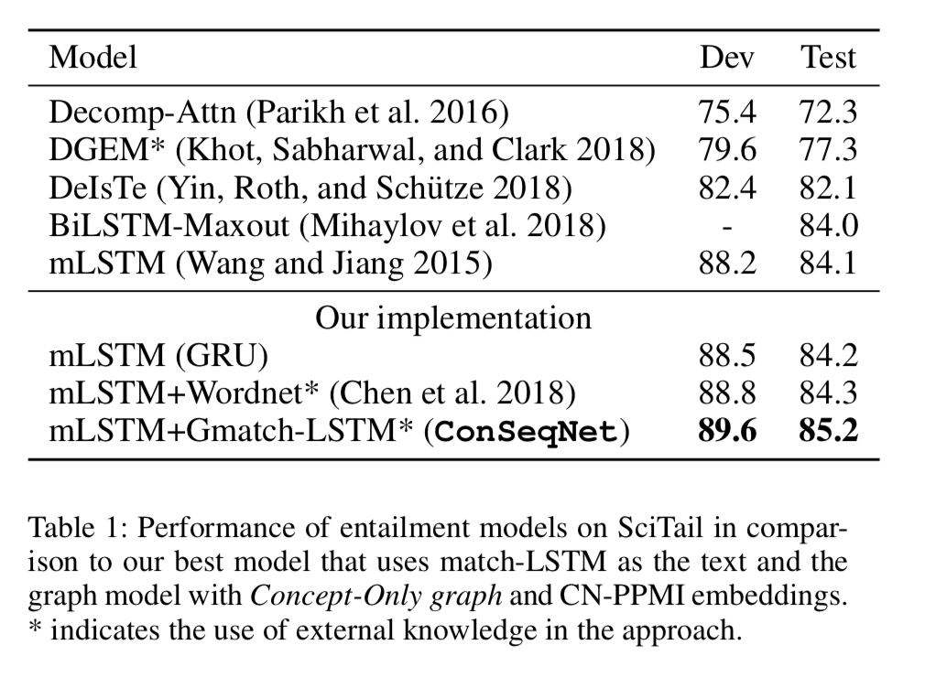
Experiments and Results – Baselines
Text Based Entailment Models
MatchLSTM+WordNet [Chen2018]
Description
mLSTM+Gmatch-LSTM
ConSeqNet
Description
Our system performs best
However, there are systems that perform better than us on the leaderboard

Slide 16
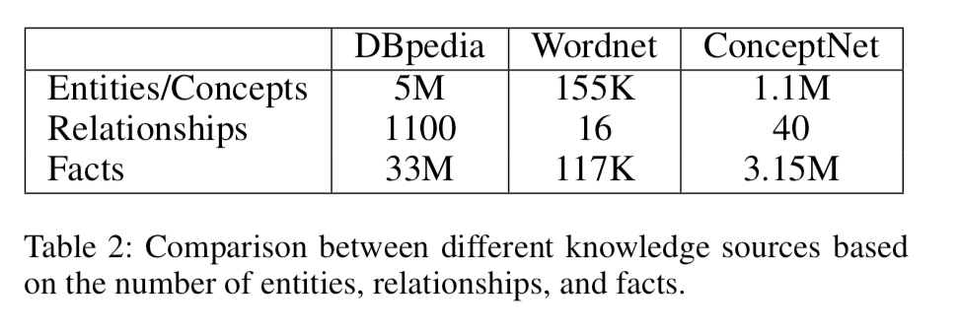
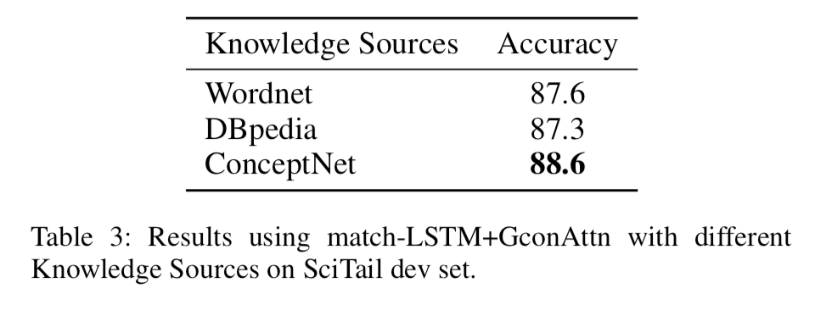
External Knowledge
Experimented with three different KGs
ConceptNet
Commonsense knowledge base
Semantic network that represents common words and phrases people use and the relationships between them.
DBpedia
Structured form of Wikipedia Infobox
Fact based:
Barack_Obama spouse_of Michelle_Obama
Wordnet
Lexical database
Mostly comprises synsets, antonyms, hypernyms, and hyponyms
Existing NLI Models that use WordNet
KIM [Chen2018] on SNLI
Results
Model: match-LSTM+GconAttn
Dataset: SciTail dev set
ConceptNet is the most apt KB for Scitail

Slide 17
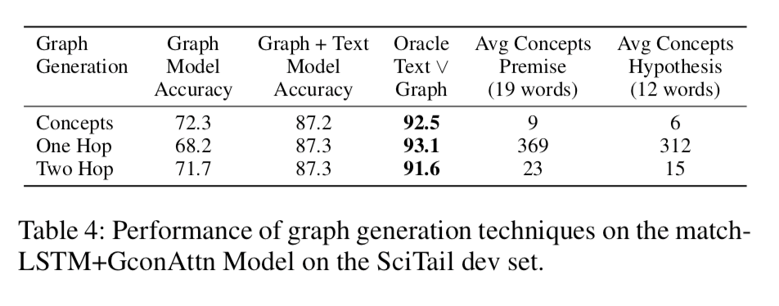
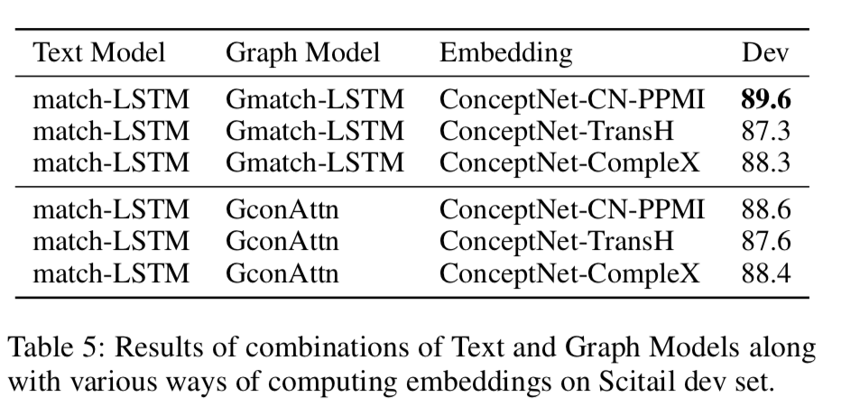
Experiments with Scitail Dev
Experimented with three different Graph Generation methodologies
Concepts Only, One Hop, Two Hop
Perfect combination of the Graph and Text Model improves accuracy significantly
Selecting Text+Graph Model
Experimented with different text and graph models to eventually narrow down to match-LSTMs

Slide 18
Conclusion and Future Work
ConSeqNet, a framework to harness external knowledge for NLI.
Utilizing ConceptNet as an external knowledge for Scitail dataset showed improved performance
Also experimented with Dbpedia, and Wordnet
Match-LSTM as text based and graph based model, with ConceptNet, has competitive performance on the Scitail dataset
85.2% accuracy

Slide 19
Thanks
Contact
Pavan Kapanipathi: kapanipa@us.ibm.com

